Slide 1
MODULE 4 – INTRODUCTION TO PERIPHERAL INTERFACING - I

Slide 2
Ppi 8255
It is a general purpose I/O designed to communicate with the external devices such as DAC, keyboard etc.
It can be used with almost all micro processors.
Has 3 8bit I/O ports – Port A, Port B, Port C all of which can be assigned as input or output ports

Slide 3
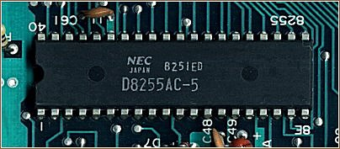
How does it actually look?

Slide 4
Characteristic features
It has 40 pins and operates in+5V power supply
Port C – 2 4-bit ports – Port C Lower and Port C Upper
Port C – can work in either bit set reset (BSR-to set or reset the bits of PORT C alone) mode or in mode 0 of I/O mode of 8255
Port B – either in mode 0 or in mode 1
Port A – either in mode 0, mode 1 or mode2

Slide 5
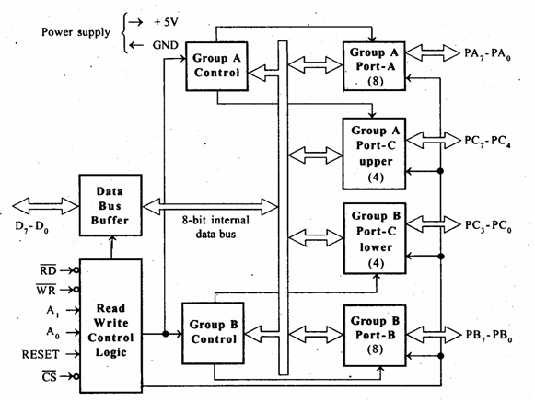
Block diagram
Source: http://8085projects.info/Peripheral-Interfacing.html as on 19 Aug 2020

Slide 6
Control modes
Control group A – Port A and Port C upper
Control group B – Port B and Port C lower
Selection of ports and modes as I/O function or BSR, is possible with the help of the pins CS’, A1 and A0.
This is done by writing the suitable word into the control pins D0 – D7.

Slide 7
Control word
CS’ | A1 | A0 | Selection | Address
0 | 0 | 0 | Port A | 80H
0 | 0 | 1 | Port B | 81H
0 | 1 | 0 | Port C | 82H
0 | 1 | 1 | Control Register | 83H
1 | X | X | No Selection | X

Slide 8
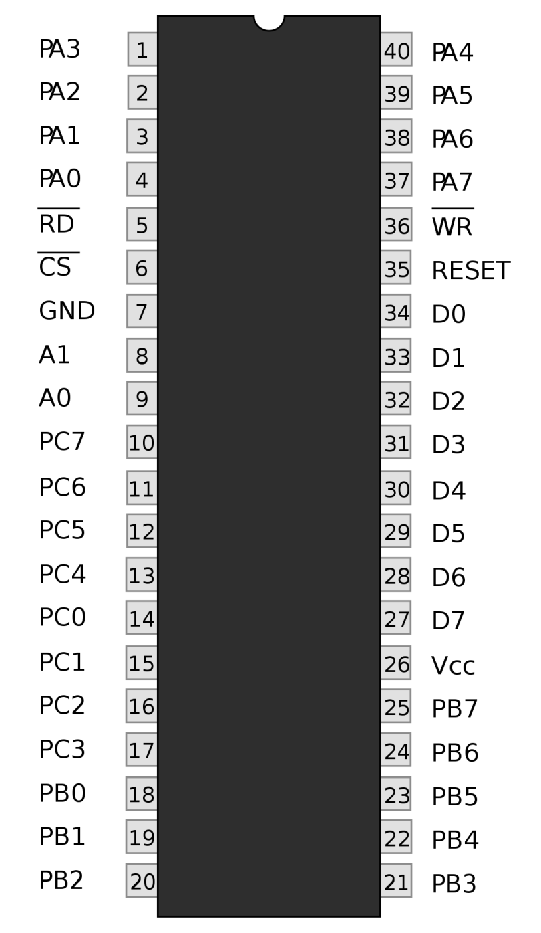
Pin diagram
PA0 – PA7 – Pins of Port A
PB0 – PB7 – Pins of Port B
PC0 – PC7 – Pins of Port C
D0 – D7 - Data pins
RESET - Reset input
RD’ - Read Input
WR’ - Write Input
CS’ - Chip Select
A1 and A0 – Address Lines
Source: https://en.wikipedia.org/wiki/Intel_8255 as on 19 Aug 2020

Slide 9
Operating modes
BSR mode
If the MSB of the control word (D7) is ‘0’, then 8255 works in BSR mode. Only Port C is used for set or reset
Control register in BSR mode
D7
D6
D5
D4
D3
D2
D1
D0
0
SET or RESET specified bit
0 – RESET
1 – SET
PORT C bit number

Slide 10
2. I/O Mode
Control register in I/O mode
D7
D6
D5
D4
D3
D2
D1
D0
1
Mode selection of Port A
00 – M0
01 – M1
1X – M2
I/O function of Port A
Mode selection of Port B
0 – M0
1 – M1
I/O function of Port C lower
I/O function of Port C upper
I/O function of Port B
When MSB is 1, then 8255 will work in I/O mode.
For I/O Function: 1 – Input, 0 - Output

Slide 11
Continued
Mode 0 – In this mode, all the ports can work as a simple input or output function. There is no interrupt handling capacity.
Mode 1 – Handshake I/O mode or Strobbed I/O mode.
Either port A or port B can work as a simple input port or output port and port C bits are used for handshake signals before data transmission.
It has interrupt handling capacity.

Slide 12
continued
For example, when a CPU wants to transfer data to the printer, first handshake signals are exchanged for synchronizing the data speed.
3. Mode 2 - Bi-directional data bus mode
In this mode, only port A works.
Port B can work in either mode 0 or mode 1.
6 bits of Port C are used for handshake signals
It can handle interrupts.

Slide 13
weblinks
https://nptel.ac.in/content/storage2/courses/106108100/pdf/Teacher_Slides/mod3/M3L2.pdf

